Slide 1
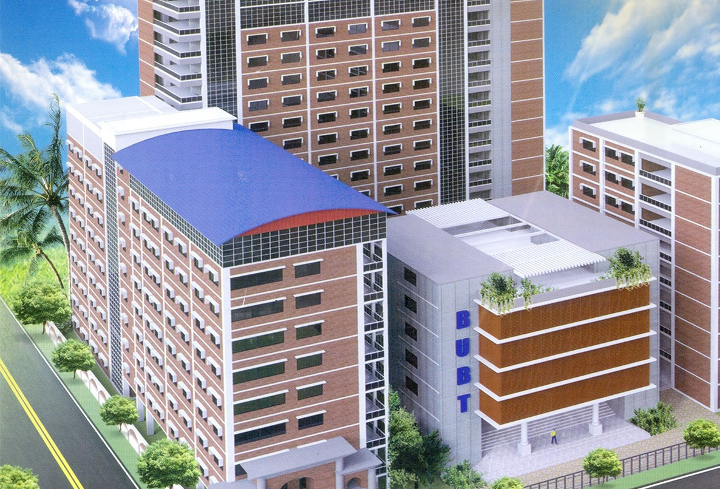

Analysis of different machine learning models for Liver disease prediction.

Slide 2
Supervised By,
T.M. Amir-Ul-Haque Bhuiyan
Assistant Professor Department of Computer Science & Engineering Bangladesh University of Business and Technology
2
Notes:
© Copyright Showeet.com – Creative & Free PowerPoint Templates

Slide 3
Presented By,
Md. Al-Imran Hossain ID:17182103318
Saimun Islam ID:17182103352
Md. Saiful Islam
ID:17182103353
Nayeem Hossain Khan
ID:17182103354
Sanjida Islam Payel
ID:17182103361
Notes:
© Copyright Showeet.com – Creative & Free PowerPoint Templates

Slide 4
Our Today’s Topics
Introduction
Existing System Problems
Proposed System
Objectives
Components
Evaluation
Result Analysis
Methodology & Flow chart
Future Scope & limitations

Slide 5
Introduction
The liver is a crucial and big organ in the human body, impacts the digestion system. Due to Liver diseases (LDs), so many deaths are occurred in worldwide that nearly 2 million deaths per year. The main LD complications are cirrhosis that 11th position in universal deaths, and others hepatocellular carcinoma and viral hepatitis that 16th leading position for global deaths. Fortunately, 3.5% of deaths are occurred due to LD. The capability of an ML approach for controlling LD can be identified through their factors, cofactors as well as complications respectively. So, in this datamining research project we want to build a project that can predict liver disease in early stage.

Slide 6
Existing System Problem
Didn’t compare the results between various machine learning models.
Can’t provide the higher accuracy then our propose system.

Slide 7
Proposed System
In this system, we have use five different machine learning models. All the machine learning model is trained by Kaggle Liver Disease Patient Dataset. Most of them is give very good result. Among them Random Forest give the highest accuracy of 99.80%.

Slide 8
Objectives
To gain practical experience by modeling an Artificial Intelligent and Data Mining technique based real world problem.
To understand how Machine Learning model and Data Mining technique work on Liver disease classification.
To develop a Machine Learning model that deals with the real-world data.
Predict Liver disease in early stage.

Slide 9
Components
Google colab.
NumPy.
Pandas.
Seaborn.
Matplotlib.
Sklearn.
Xgboost.
Dataset (Indian liver patient)

Slide 10




Evaluation
To classify Liver disease we use five supervised machine learning models ; those equation are given bellow:
Logistic Regression:
y = log(p/1 – p)
XGBoost:
Naive Bayes:
P(A/B) = P(B/A)P(A)/P(B)
Decision Tree:
&
Random Forest:

Slide 11
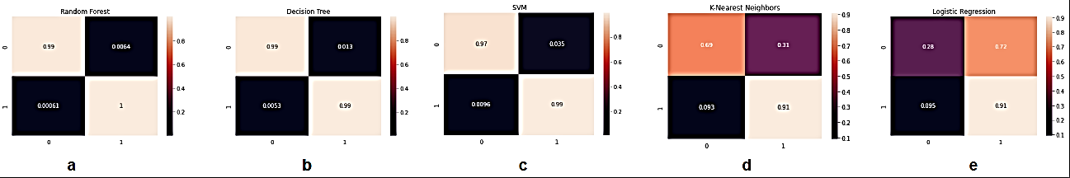
Result Analysis
Confusion Matrix

Slide 12
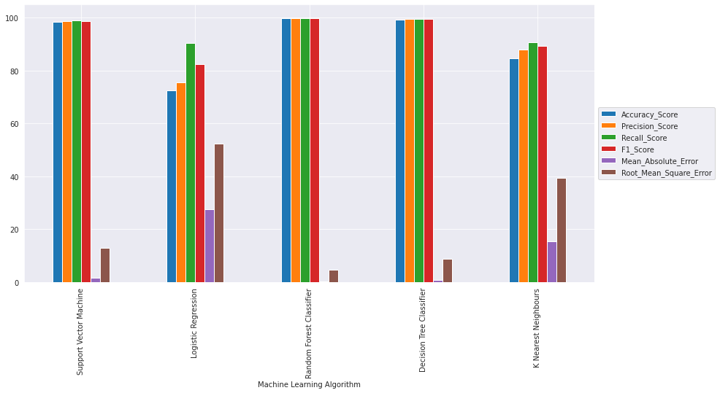
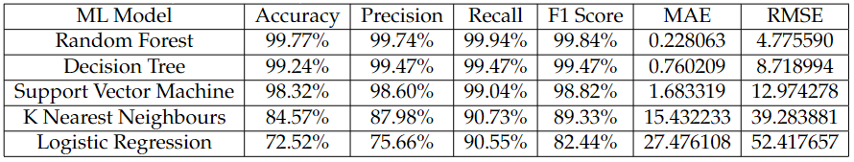
Result Analysis

Slide 13
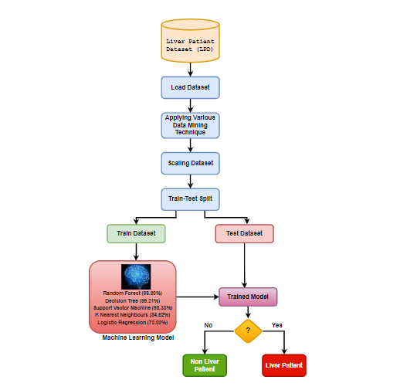
Methodology & Flowchart
Dataset loading.
Applying Various Data Mining Technique.
Scaling Dataset.
Dataset splitting.
Machine Learning Model Training.
Prediction.
Flow Chart

Slide 14
Future
Adding some ensemble method to increase accuracy of our model.
Applying data synthesis method to increase dataset.
Developing an application for android devices that works on the same database.
Putting this model on network and updating it through internet.

Slide 15
15

